Slide 1

Azure Function
Author: Chien.Do
Nov, 2022

Slide 2



TABLE OF CONTENTS
01.
04.
07.
WHAT IS AZURE
FUNCTION ?
PROXIES
PRICING
02.
05.
08.
BENEFITS
DURABLE FUNCTION
SERVERLESS
ARCHITECTURE
03.
06.
09.
TRIGGERS &
BINDINGS
DEMO
Q&A
Notes:
move serverless to end

Slide 3



WHAT IS
AZURE FUNCTION ?

Slide 4
What is Azure Function ?
Function as a Service (FaaS) offering that allows developers to focus on writing code and not worry about maintaining the underlying computing infrastructure.
Azure Function = Code + Events
Support different programming language (C#, F#, Java, Javascript,..)
Notes:
-Code is something that you would write based on an event that is fired.
UseCase for Azure function.
Best practice

Slide 5
BENEFITS

Slide 6
Benefits
Support a lot of programming languages
Easier to write and deploy code.
Do not need to setup infrastructure.
Compute-on-demand
Saving cost and scalable
Notes:
-cost (chi phi van hanh, con nguoi)
-saving cost :
+ chi phí vận hành: Uptime
+ con người:
Manage activity of durable function
Scalable: Run by it own.
Scalable by function : scope of azure function,
Scalable by all system : big system all azure function combined, which mean scale system
Compute-on-demand: use by needs (except timer)

Slide 7
Triggers and bindings concepts

Slide 8
Triggers and bindings concepts
Triggers cause a function to run.
A trigger defines how a function is invoked and a function must have exactly one trigger.
Triggers have associated data, which is often provided as the payload of the function.
Binding to a function is a way of declaratively connecting another resource to the function
Bindings may be connected as input bindings, output bindings, or both.
Data from bindings is provided to the function as parameters.

Slide 9
Triggers and bindings concepts
scenario | Trigger | Input binding | Output binding
Queue message arrives and return to another Queue | Queue |  | Queue
A scheduled job reads Blob Storage contents and creates a new Azure Cosmos DB document. | Timer | Blob Storage | Azure Cosmos DB
A webhook that uses For payment | HTTP
Notes:
Beside these, there’re others

Slide 10




Triggers
Timer
Queue Message
HTTP Trigger
TRIGGERS
More: CosmosDB trigger, Azure Blob, Send Grid, etc.
Notes:
Timer: will trigger at period time as config
Queue message: As soon as a new message is received in the actual queue, this will be executed.
HTTP Request Web API or webhooks: This will have url, when the url being called with HTTP Verb (GET, POST, PUT), that point function will be executed.
Azure blob: that will store file
SendGrid: use to send mail.

Slide 11
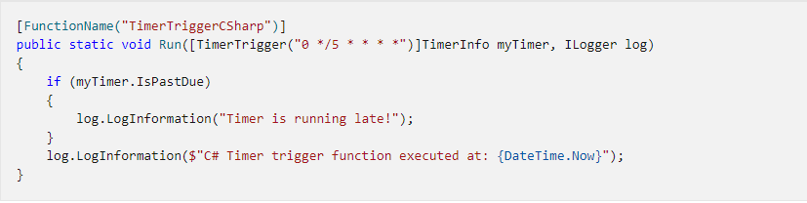
Timer
Run on schedule

Slide 12
Timer - NCRONTAB expressions
{second} {minute} {hour} {day} {month} {day-of-week}
Example | When triggered
0 */5 * * * * | Once every five minutes
0 * 5 * * * | At every minute in the hour, beginning at hour 5
0 0 */2 * * * | Once every two hours
5,8,10 * * * * * | Three times a minute - at seconds 5, 8, and 10 during every minute of every hour of each day
Notes:
A TimeSpan can be used only for a function app that runs on an App Service Plan.
You can put the schedule expression in an app setting and set this property to the app setting name wrapped in % signs, as %ScheduleAppSetting%.
For schedules that trigger more than once per minute, the default is false.

Slide 13
Timer - NCRONTAB expressions
The numbers in a CRON expression refer to a time and date, not a time span.
For example, a 5 in the hour field refers to 5:00 AM, not every 5 hours.
The default time zone used with the CRON expressions is Coordinated Universal Time (UTC).
Notes:
To have your CRON expression based on another time zone, create an app setting for your function app named WEBSITE_TIME_ZONE.
WEBSITE_TIME_ZONE is not currently supported on the Linux Consumption plan.

Slide 14

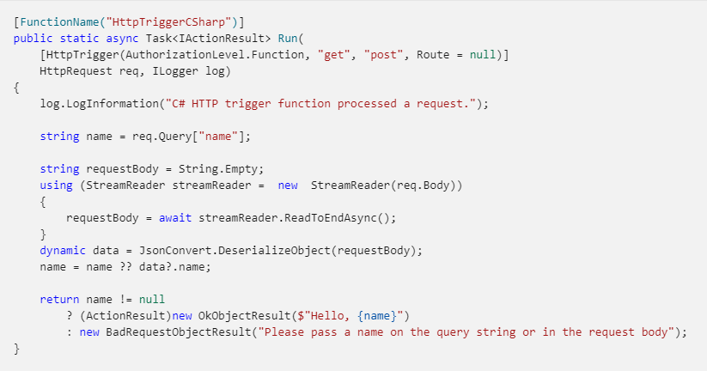
HTTP Trigger
The HTTP trigger lets you invoke a function with an HTTP request.
You can use an HTTP trigger to build serverless APIs and respond to webhooks.
AuthLevel | Description
anonymous | No API key is required.
function | A function-specific API key is required. This is the default value when a level isn't specifically set.
admin | The master key is required.

Slide 15
HTTP Request - Authorization scopes
Function-level keys - There are two access scopes:
Function: These keys apply only to the specific functions under which they are defined.
Host: can be used to access all functions within the function app.
Master key (admin-level):
Providing host-level access to all functions in the app, the master key also provides administrative access to the runtime REST APIs.
When you set an access level of admin, requests must use the master key; any other key results in access failure.
Notes:
When used as an API key, these only allow access to that function.
When used as an API key, these allow access to any function within the function app.

Slide 16
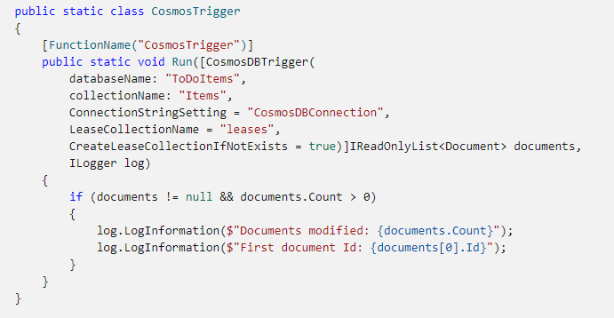
Cosmos DB trigger
The Azure Cosmos DB Trigger uses the Azure Cosmos DB Change Feed to listen for inserts and updates across partitions.

Slide 17
Bindings
Queue
Cosmos DB
Blob Storage
SendGrid
HTTP & webhook
others
BINDINGS
Notes:
Azure function also provide concept of input & output Binding to make it easy to integrate with other services.
For example, instead of connecting to queue and post message, we just need to setup queue output binding, the logic will automatically sending it. Also simplify get data in function (in CosmosDB). it will put as input param in your function.
All theses big part why Azure function such as rapid development flatform.
forcus on core business.

Slide 18
PROXIES

Slide 19
PROXIES
The basic idea behind Azure Function Proxies is that they allow us to define a single API surface for multiple function apps
Now any function app can define an endpoint that serves as a Reverse Proxy for another API.
The endpoint can be a function app or it can be anything else.

Slide 20

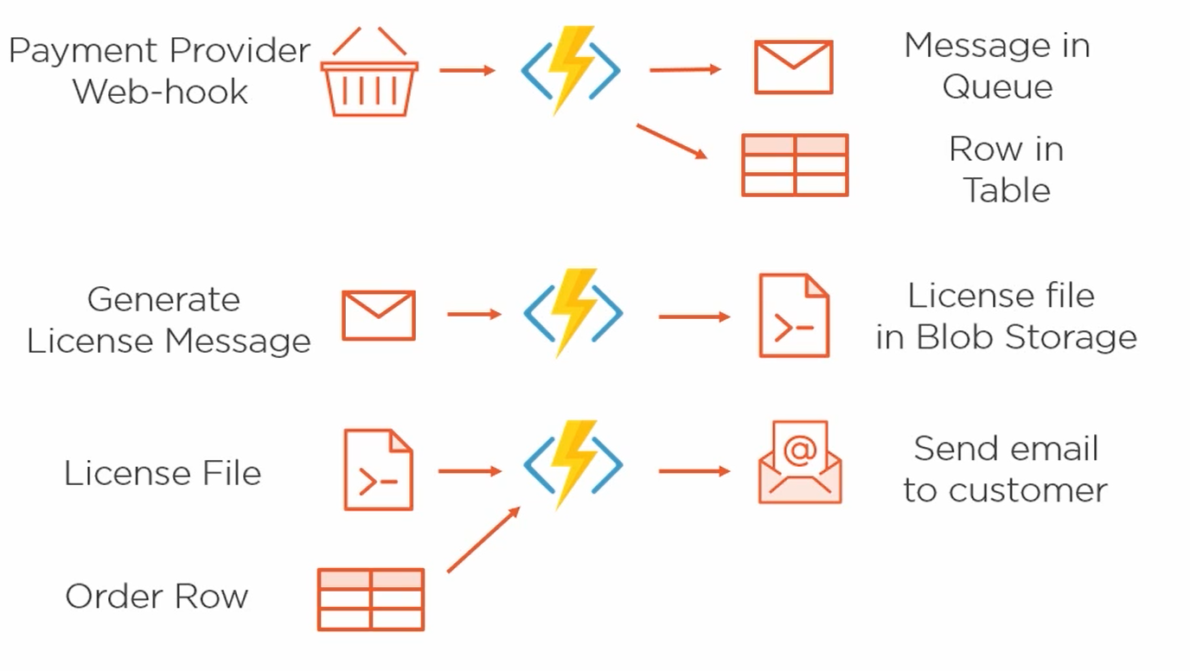
DEMO

Slide 21
DUBRALE FUNCTION

Slide 22
Durable Function
This is an extension of Azure Functions that lets you write stateful functions in a serverless compute environment.
The extension lets you define stateful workflows by writing orchestrator functions and stateful entities by writing entity functions using the Azure Functions programming model.
Behind the scenes, the extension manages state, checkpoints, and restarts for you, allowing you to focus on your business logic.

Slide 23
Durable Function
The primary use case for Durable Functions is simplifying complex, stateful coordination requirements in serverless applications. Application Pattern benefit from Durable Function:
Function chaining
Fan-out/fan-in
Async HTTP APIs
Monitoring
Human interaction
Aggregator (stateful entities)

Slide 24
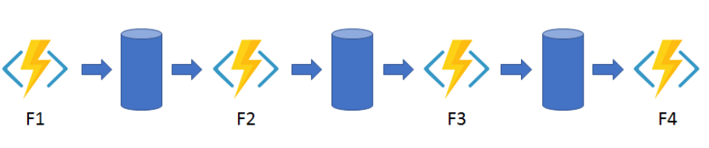
Durable Function - #1: Function chaining
executing a sequence of functions in a specific order. In this pattern, the output of one function is applied to the input of another function.

Slide 25
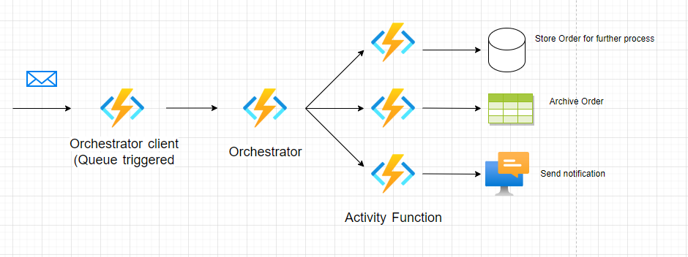
Durable Function - #1: Function chaining

Slide 26
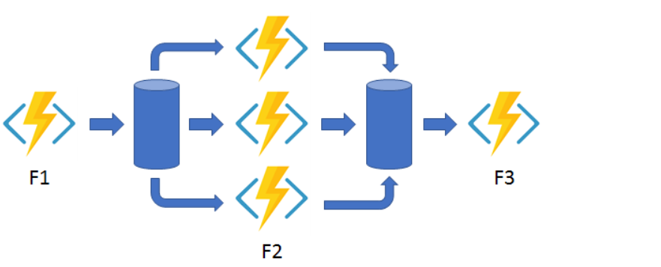
Durable Function - #2: Fan out/fan in
Fan-out/fan-in: the pattern of executing multiple functions in parallel and then waiting for them all to finish.
Notes:
process list order

Slide 27
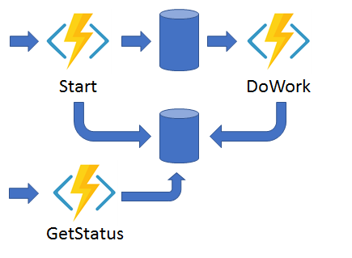
Durable Function - #3: Async HTTP APIs
The async HTTP API pattern addresses the problem of coordinating the state of long-running operations with external clients.
A common way to implement this pattern is by having an HTTP endpoint trigger the long-running action. Then, redirect the client to a status endpoint that the client polls to learn when the operation is finished.

Slide 28
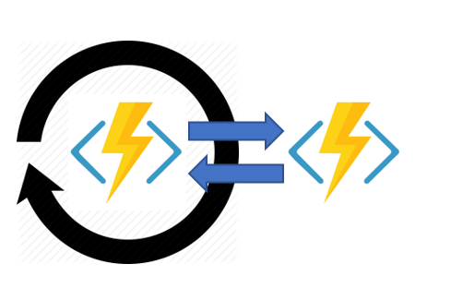
Durable Function - #4: Monitor
The monitor pattern refers to a flexible, recurring process in a workflow such as polling until certain conditions are met.
You can use Durable Functions to create flexible recurrence intervals, manage task lifetimes, and create multiple monitor processes from a single orchestration.

Slide 29
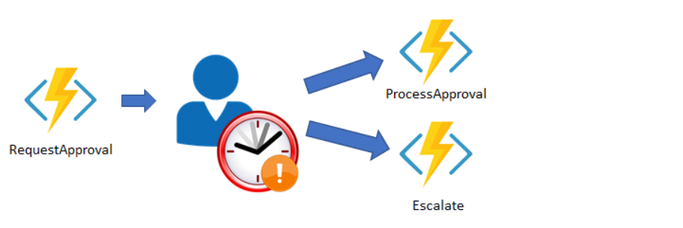
Durable Function - #5: Human interaction
Many automated processes involve some kind of human interaction. Involving humans in an automated process is tricky because people aren't as highly available and as responsive as cloud services
An automated process might allow for this interaction by using timeouts and compensation logic.

Slide 30
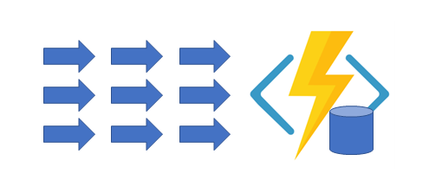
Durable Function - #6: Aggregator (stateful entities)
This pattern about aggregating event data over a period of time into a single, addressable entity.
Data being aggregated may come from multiple sources, may be delivered in batches, or may be scattered over long-periods of time.
The aggregator might need to take action on event data as it arrives, and external clients may need to query the aggregated data.
Notes:
dùng để aggregate data
nó có state để quản lý statefull
vd cụ thể là điếm lượt like or vote bài viết như trong fb á
bình thường thì các request là riêng lẻ, ở đây câu hỏi là làm sao aggrate nó với nhau
thì cái pattern này nó giúp mình tạo state để all request có thể reused
nhưng mà có 1 điểm yếu nó chỉ apply cho 1 instance function thôi, nếu scale out thì lại ko dc
state là dạng cache lại và tất cả các request sử dụng chung data

Slide 31
DEMO

Slide 32
BEST PRATICES & SCENARIO

Slide 33
Best practices
Functions should "do one thing“.
Functions should finish as quickly as possible.
Should choose Windows host when create Function.
Notes:
Because generally Microsoft Azure better supports compute running Windows.

Slide 34
Scenarios
Business
Reminders and Notifications
Lightweight Web API, POC
Scheduled tasks
Technical
Send mails
Order, File processing
Computing backend calculations

Slide 35
Pricing
Consumtion Plan
Premium Plan
Dedicated Plan
Notes:
Consumtion : disadvantage: frezze, not always start. Usage for small function
Premium Plan: Dedicated Plan

Slide 36
Pricing - Consumption Plan
Only pay when your code is running.
Billing is based on the number of executions, the duration of each execution, and the amount of memory used.
Notes:
Consumtion : disadvantage: frezze, not always start. Usage for small function
Premium Plan: Dedicated Plan

Slide 37
Pricing - Premium Plan
Azure provides any additional computing services that are required when your function is running.
You pay for the constantly pre-warmed instances including any additional instances needed to scale the Azure app in/out.
Notes:
Consumtion : disadvantage: frezze, not always start. Usage for small function
Premium Plan: Dedicated Plan

Slide 38
Pricing - Dedicated Plan ( VM sharing)
When you use App Service for other apps, your functions will run on the same plan (VMs) at no extra cost.
You may scale it out manually by adding more VM instances for an App Service plan.
Notes:
Consumtion : disadvantage: frezze, not always start. Usage for small function
Premium Plan: Dedicated Plan

Slide 39
SEVERLESS ARCHITECTURE
Servers are managed for you (not thinking about server, focus on business)
Per-second billing model (only pay when your function running)
Automatic scale(multiple servers meet the demand)

Slide 40
Q&A

Slide 41
THANK YOU!

